Slide 1

Strengthening Neural Networks: Insights from FGSM and CW Adversarial Attacks

Slide 2

Project Summary
Our team systematically implemented two prominent adversarial attack methods, Fast Gradient Sign Method (FGSM) and Carlini-Wagner (CW), on Deep Neural Network (DNN) classifiers. Our primary focus was on evaluating the impact of these attacks by analyzing the Euclidean distances between the original images and their corresponding adversarial counterparts.
Through rigorous experimentation and analysis, we gained valuable insights into the effectiveness of FGSM and CW attacks in inducing subtle yet impactful perturbations. The examination of Euclidean distances served as a quantitative measure of the perceptual similarity between the original and adversarial images, highlighting the challenges of detecting adversarial manipulations visually.
Building on these findings, our project delved into discussions on strategies to enhance the resilience of DNN classifiers against adversarial attacks.

Slide 3
Team Organization Adam Abaker, Akinboye Yusuff Muhammad Ali Imdad Awan, Eniola Akinbileje, Daniel Stephens, Jaavon Matthews
Team Member | Contribution
Daniel Kofi Stephens | Group leader
Jose Dominguez | Adversarial Training (Defence Mechanism)
Akinboye Yusuff | FGSM Attack
Muhammad Ali Awan | CW Attack
Eniola Akinbileje | CW Attack
Adam Abaker | Adversarial Training (Defence Mechanism)
Jaavon Matthews | FGSM Attack

Slide 4

Introduction
Our project delves into implementing Fast Gradient Sign Method (FGSM) and Carlini-Wagner (CW) attacks on a deep neural network classifier. We then discuss ways to make a model more resilient to attacks.
As AI becomes integral to security-sensitive applications, understanding and mitigating vulnerabilities is important
Our analysis, employing Euclidean distances, unveils the nuanced impact of adversarial perturbations.
Significantly, our project not only evaluates specific attack methods but also propels discussions on fortification strategies, contributing to the creation of more resilient models.
In an era of escalating AI integration, our work is crucial for ensuring the reliability and security of DNNs in practical, real-world scenarios.

Slide 5

Methodology
Dataset Selection: MNIST handwritten dataset. It is a standardized dataset for research purposes.
Building and Training the model: We used keras API to build a deep neural network classifier on the dataset. Our model achieved an accuracy of 99.04%
Adversarial Attack Implementation: Implemented the Fast Gradient Sign Method (FGSM) and Carlini-Wagner (CW) attacks to generate adversarial examples from the original test dataset.
Euclidean Distance Calculation: Compute the Euclidean distances between the original and adversarial images to quantify the perturbation introduced by the attacks.
Results Analysis: Analyzed the results, focusing on the impact of adversarial attacks on model predictions, classification accuracy, and the distribution of Euclidean distances.
Insight Generation: Derived insights from the analysis, identifying patterns or trends in how the attacks affect the DNN classifiers.
Resilience Strategies: Discuss and propose strategies to enhance the adversarial resilience of your models. This could include adversarial training, robust optimization, or the implementation of specific defense mechanisms.

Slide 6
FGSM Attack
The Fast Gradient Sign Method (FGSM) crafts adversarial examples by computing the gradient of the model's loss with respect to the input and applying a small perturbation in the direction of the gradient's sign.
This quick and computationally efficient one-step attack maximizes the model's error, generating adversarial inputs that often lead to misclassifications.
The strength lies in its simplicity, but its effectiveness may diminish against models explicitly trained for robustness against adversarial perturbations.

Slide 7
Carlini-Wagner Attack
The Carlini-Wagner (CW) attack is a sophisticated optimization-based method for generating adversarial examples.
CW formulates an optimization problem to find the smallest perturbation that leads to misclassification.
Unlike simpler methods, CW considers the model's confidence, allowing it to create highly effective adversarial examples with minimal perceptual changes.
The attack aims to find perturbations that are both small and evade detection, making it powerful against a wide range of models.

Slide 8

Data information
Number of data attacked = 100
Successful attacks:
FGSM: 100
CW attack: 87

Slide 9
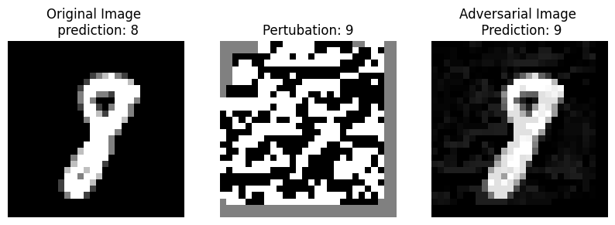
Results
FGSM Attack

Slide 10
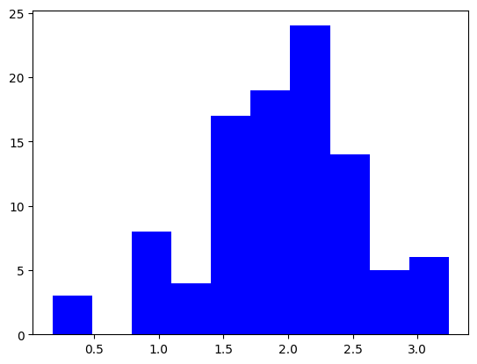
Results
FGSM - Euclidean Distance
Maximum: 3.240561
Minimum: 0.1798066
Average: 1.93666

Slide 11
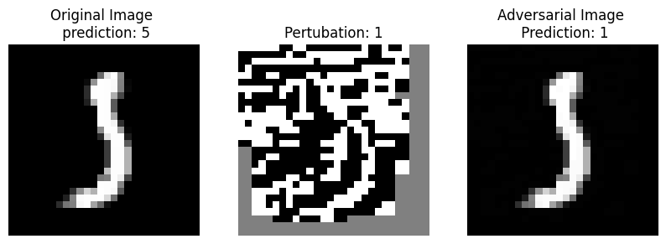
Results
Minimum Perturbation: 0.1798066

Slide 12
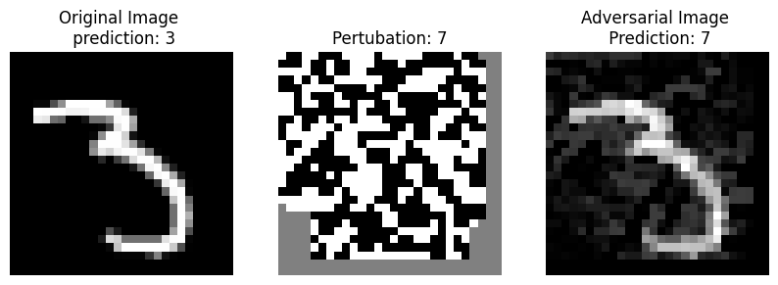
Results
Maximum Perturbation : 3.2420561

Slide 13
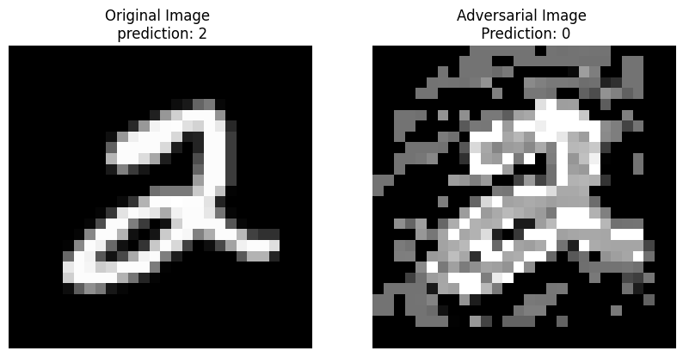
Results
CW attacks

Slide 14
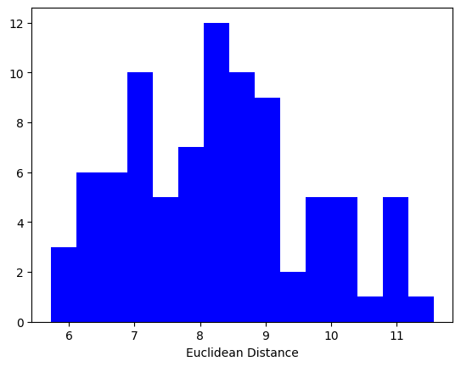
Results
Maximum: 5.7212296
Minimum: 11.56983
Average: 8.283451

Slide 15
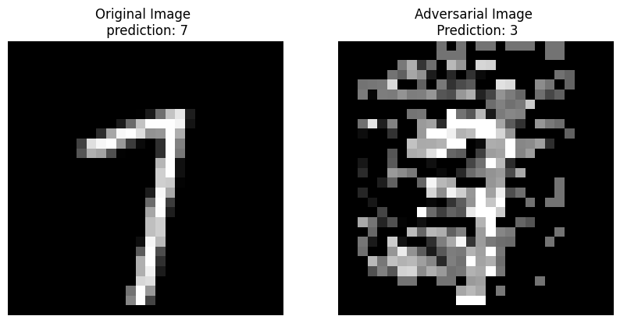
Results
CW attack minimum:

Slide 16
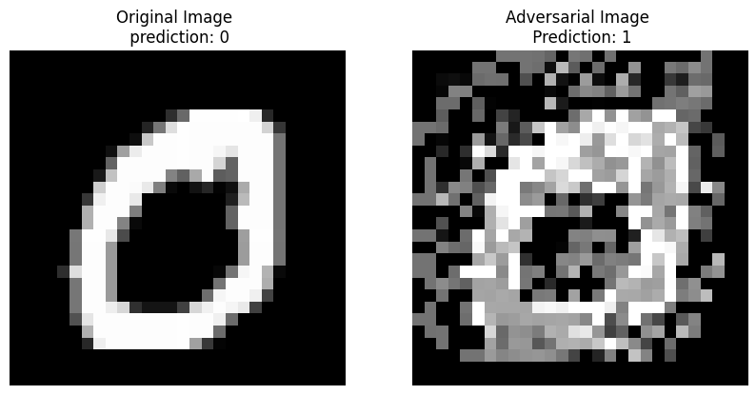
Results
Maximum Perturbation:

Slide 17
Insights
Perceptual Quality: A low Euclidean distance suggests that the adversarial images from FGSM are perceptually similar to the original ones, making them potentially more effective in real-world scenarios where visual differences are crucial.
Stealthy Attacks: FGSM, due to its low Euclidean distances, may be considered a stealthier attack as it can achieve its goals while maintaining visual similarity, potentially bypassing defenses relying on perceptual differences.

Slide 18
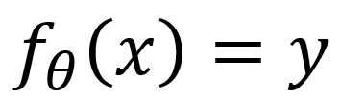

Defence Mechanisms
Defense:
A modification to the training process of NN to make it resistant to attacks.
Adversarial training:
white-box attack training (AKA reverse UNO)
NO adaptive/innovative method has been proposed yet.

Slide 19

White-Box Adversarial Training
Objective: Train classifier to ensure adversarial perturbations get correctly classified.
FGSM example:
Instead of optimizing
at training phase.
Now, optimize

Slide 20
Adversarial training defence mechanism
Adversarial training is a defense mechanism against adversarial attacks in the context of machine learning, particularly for models like neural networks. Adversarial attacks involve deliberately crafting input data to mislead a model and cause it to make incorrect predictions. Adversarial training aims to make machine learning models more robust by training them on both clean and adversarial examples.

Slide 21
Here's a general overview of how adversarial training works:
Generate Adversarial Examples:
During the training phase, alongside the regular training data, adversarial examples are generated.
Adversarial examples are created by making small, carefully crafted perturbations to the input data to trick the model.
Update Model Parameters:
Train the model on both clean and adversarial examples.
Adjust the model parameters to minimize the error on both types of examples.
Repeat:
The process is typically repeated iteratively, with the model being exposed to both clean and adversarial examples in each iteration.
This helps the model to learn to be robust to small perturbations in the input data.
Evaluate Performance:
Periodically, the model is evaluated on a separate validation set that includes both clean and adversarial examples.
The goal is to ensure that the model generalizes well to both types of inputs.

Slide 22
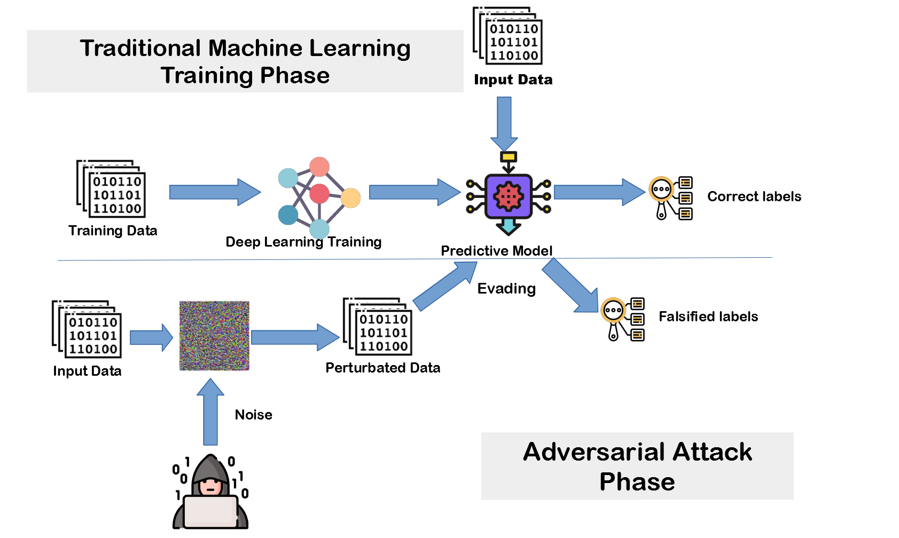

Slide 23
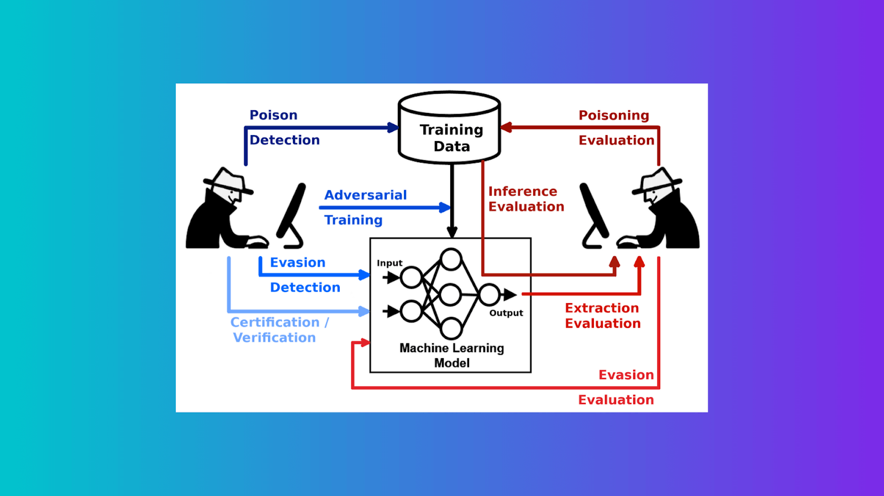

Slide 24
Filtering method on adversarial attack
Filtering methods in the context of adversarial attacks refer to techniques used to identify and discard adversarial examples before they can impact the performance of a machine learning model. These methods are designed to act as a pre-processing step to filter out potentially harmful inputs.
Here are some common filtering methods:
Input Space Defense:
Input Normalization: Normalize the input data to a specific range or distribution to reduce the impact of adversarial perturbations.
Input Whitening: Whiten the input data by applying transformations to reduce dependencies between features.
Feature Space Defense:
Feature Squeezing: Reduce the bit-depth or precision of input features to make it harder for attackers to craft effective adversarial examples.
Principal Component Analysis (PCA): Use PCA to transform the input data into a lower-dimensional space, potentially removing noise introduced by adversarial perturbations.
Adversarial Sample Detection:
Statistical Methods: Use statistical techniques to detect samples that deviate significantly from the distribution of clean samples.
Outlier Detection: Identify samples that lie far from the majority of the data, assuming that adversarial examples are outliers.
Ensemble Methods:
Adversarial Training (mentioned earlier): Train multiple models on both clean and adversarial examples and ensemble their predictions to improve robustness.
Diverse Models: Train models with different architectures or initializations and use their collective decision-making to identify and filter out adversarial examples.
Certification Methods:
Verified Robustness: Use mathematical methods to certify that a model is robust within a certain region of the input space, rejecting inputs falling outside this region.
Input Reconstruction:
Reconstruction from Intermediate Representations: Reconstruct input samples from intermediate representations within the model, discarding those that cannot be accurately reconstructed.

Slide 25
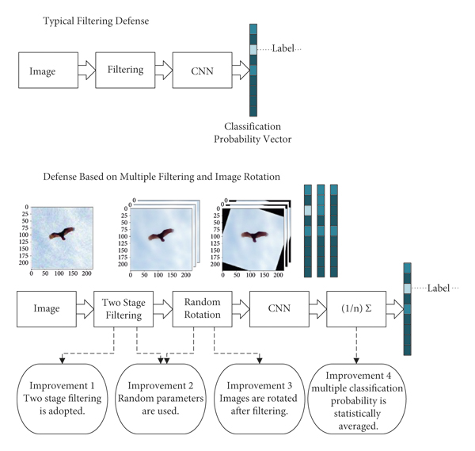
Filtering methods’ accuracy degrades in defending against adversarial attacks

Slide 26
Conclusions
DNNs are vulnerable to adversarial attacks
confuse models(AKA fooling)
Countermeasures are capable of reducing the attempt to confuse a model.
Adversarial training

